Slide 1

Biol 243 Exam Review
Bioinformatics club

Slide 2
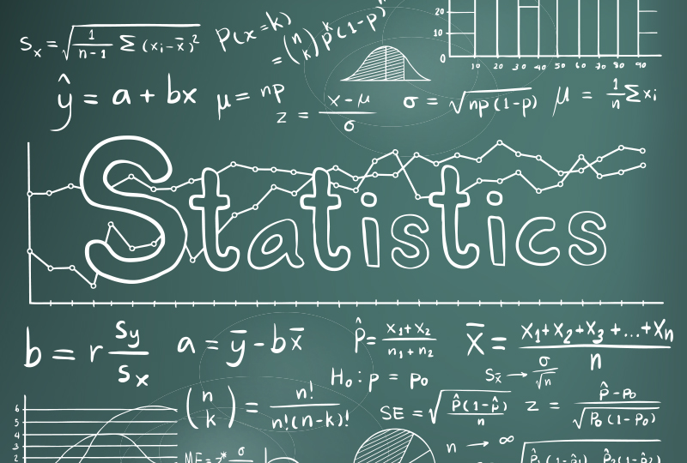
Agenda
Introduction
Module review
Past exam question review
Study and question time
End of session

Slide 3

Introduction
Presenters: Catarina, Dhannya, Quelin, Kaan
This is a review session for the Biol 243 course. This is meant to be complimentary to your own studying, not a substitute for it. Not everything will be covered in this session, however we will do our best to highlight the key concepts.

Slide 4

Module Review

Slide 5
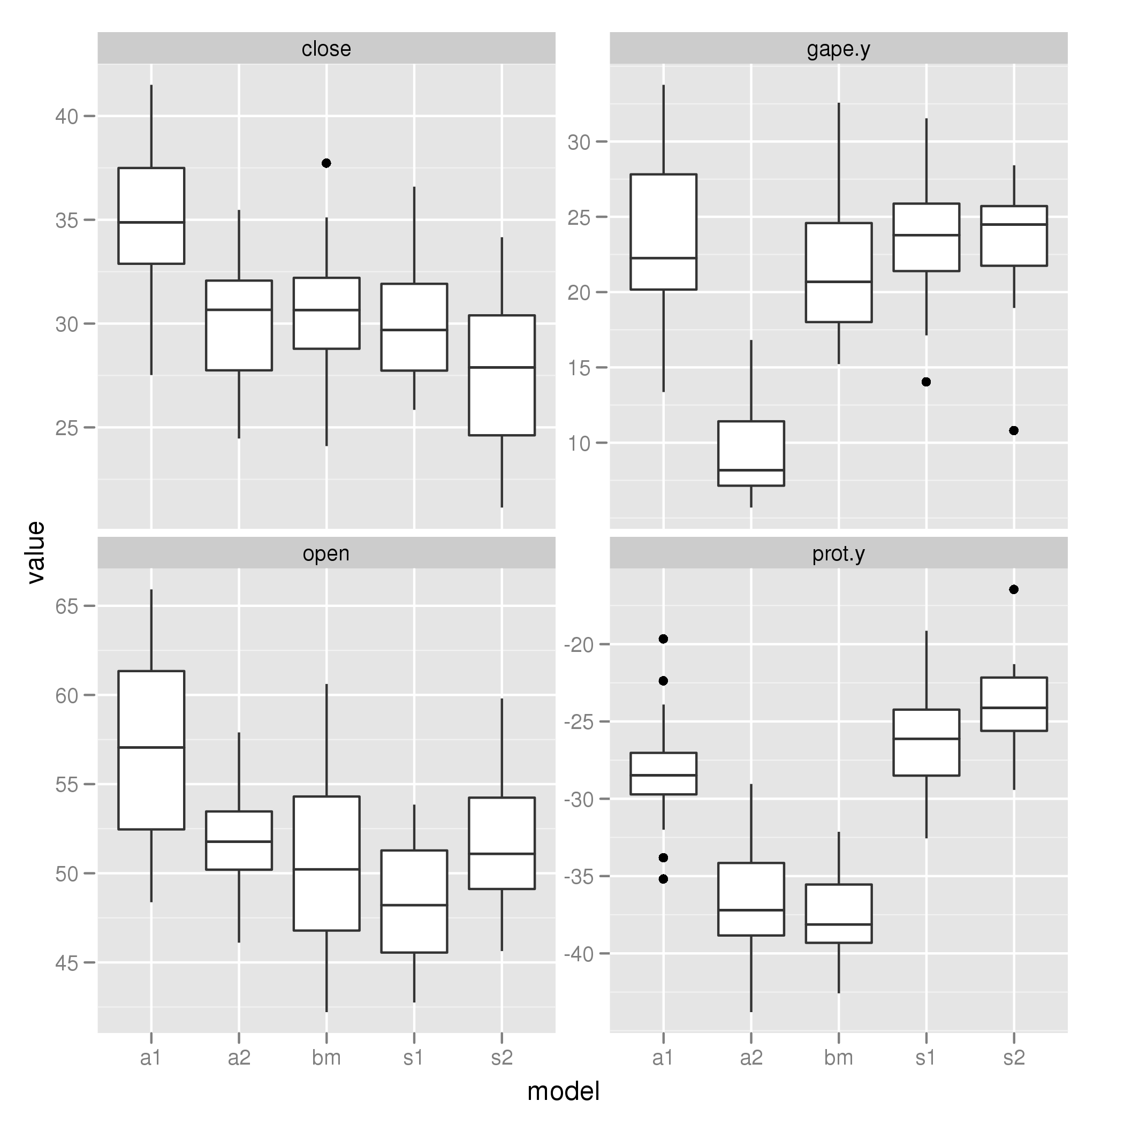

Module 1
Statistical population
collection of all sampling units that could be selected
Population of interest
the group you want to make a statement about
Observation unit
what you measuring something about or the unit you collect data from
Sampling unit
a single unit selected randomly
Sample
collection of selected sampling units
Measurement variable
the data collected. (E.g. Height (cm), age (years), how often u bike (days of the week), etc.)
Measurement unit
units associated with the measurement variable
categorical data has no measurement unit
Descriptive statistics
set of tools used to describe the data in your sample.
this includes calculating quantitative descriptions (e.g., average values) and creating graph
Inferential statistics
set of tools used to say something about the statistical population based on your sample.
this includes things like confidence intervals and statistical tests.

Slide 6


Module 2
Bias
Over or under estimation of a value from an average sample compared to the statistical population
Blocking
Groups determined ahead of time that account for variation the researcher is not interested in
Confounding variable
An unobserved variable which may affect both the explanatory and response variables
Cross-sectional study
Snapshot of the population at a single point in time
Explanatory variable
Variable that an investigator believes may explain the response variable
Interactions
Response generated from a multi-factor study which differs from the responses from the simple effect of each isolated factor
Level
The manipulated value within each factor (manipulated variable)
Placebo
Substance or treatment which has no effect on the response variable

Slide 7




Module 2 Cont.
Prospective study
Selects sampling units before the response of interest has occurred
Pseudo replication
Error created when the units used in a study are not the proper sampling units
Replicate
The number of sampling units in each level of each factor
Response Variable
Variable that the investigator believes may answer a research question
Retrospective Study
Selects sampling units after the response of interest has occurred
Sampling Independence
Selection of one sampling unit which does not influence the probability of other units being selected
Spurious Relationship
Relationship between the explanatory and response variables is largely driven by confounding variables
Stratified Survey
Researcher defines the strata (subgroup) that represent natural grouping in the population then proceeds with a simple random survey in each strata

Slide 8
Module 3
Variables
Any measurable characteristic of an observation unit
Types
Categorical: qualitative levels
Nominal has unordered levels
Ordinal have ordered levels
Numerical: numeric levels
Continuous can have non-integer values
Discrete can only have integer values
Counts
Used for categorical variables
The number of observations a sample falls into
Mean
Average value in the sample
Median
Middle value of your sample when the values are ranked lowest to highest
Proportions
Used for categorical variables
The share of observations in the sample that fall into each category

Slide 9
Module 3 Cont.
Quartile
One quarter of your sample when it is ranked lowest to highest
Interquartile range
The difference between the 3rd and 1st quartiles which gives you the range of the innermost 50% of a numerical sample
Standard deviation
Square root of the variance
Variance
Typical squared distance of the numerical values from the mean
Effect size
The change in mean value response among groups
Ratio
Y1 ÷ Y2 where Y1 is the mean of the group 1 samples and Y2 is the mean of the group 2 samples
Difference
Y1 - Y2 where Y1 is the mean of the group 1 samples and Y2 is the mean of the group 2 samples

Slide 10
Module 4
Contingency Table
Tables in which different frequencies/proportions are listed in different levels of categorical variables
Bar graph
Type of figure used to visualize categorical data
The base separates the levels of a variable, and the height is the number of samples
Histogram
Type of figure used to visualize numerical data
The base is the numerical data which is divided into bins and the frequency gets plotted into each bin
Box Plot
Figure used to visualize numerical data
Parts of the plot:
The box is the interquartile range
The extreme threshold is a temporary reference line used for the whiskers & extreme values. These extend 1.5x the box past its boundaries
The solid line is the median
The whiskers are the lines drawn from the edge of the box to the last datapoint within the extreme threshold. (No whiskers if all data points are inside the box or outside the extreme threshold)
Line plot
Type of figure to visualize data with two numerical variables when there are repeated measurements on sampling units
Scatter plot
Figure used to visualize data with two numerical variables when there are no repeated measurements on sampling units

Slide 11
Module 5
Event
Any subset of the sample space
Probability
The proportion of times an event would occur if a random trial were repeated many times
Sample space
Set of all possible outcomes
Probability density
Y axis of a continuous probability distribution
Probability distribution
Functions that describe the probability over a range of events
Probability mass
Y axis of a discrete probability distribution
Core
Specific value on the x axis of a probability distribution
Standard normal distribution
Special form of the normal distribution with mean of 0 and standard deviation of 1
Z-score
Name given to the score on the normal distribution

Slide 12
Module 6
Population Distribution
Distribution throughout the entire set of individuals items, or data under study
Sampling Distribution
Distribution of a sample drawn from the population. Forms a smooth bell-shaped distribution
Central Limit Theorem
Calculate the mean and standard deviation of the sampling distribution without constructing it
Adds the following details:
Sampling distribution tends towards a normal distribution the larger it gets
Mean of the sample distribution is the same as the mean of the statistical population
Standard error (SE) is the standard deviation of a sampling distribution
SE can be calculated from standard deviation (σ) of the statistical population and the sample size (n) as: SE = σ / √n
T-distribution
The Standard Deviation of the statistical population must be estimated from a sample (s), so SE is given by SE=s/√n
Confidence intervals
Convey uncertainty in descriptive statistics and describe a range on the x axis bracketing a certain probability where new samples may be found
Calculated by:
Find the intervals on the standardized scale. We find the standardized t-scores, which we can label tL and tU to represent the lower and upper confidence interval on the standardized scale.
Convert to raw scale. We will use xL and xU to represent the lower and upper confidence intervals on the raw scale. The raw-scale confidence intervals are calculated as

Slide 13
Module 7
Null Hypothesis (H0)
Outcome that we are not interested in. would mean the pattern we are interested in does not exist.
Alternative Hypothesis (HA)
Statement that is the positive viewpoint of our research outcome. Would mean the pattern we are interested in does exist.
Directionality
Wether the measurement variable has direction in H0 and HA
Nondirectional means there should be a difference in the alternative hypothesis while directional states the difference should be in a specific direction
Null Distribution
Sampling distribution we expect from sampling a statistical population governed by H0
Statistical significance
Conclusion that a set of data are unlikely to form H0
Type I Error Rate (aka alpha (⍺)
Probability of rejecting H0 when it is true
Used to determine the point in which data should be rejected and is set by the researcher prior to referencing data
P-Value (p)
Probability of seeing your data under the null hypothesis – determined by data

Slide 14
Module 7 cont.
If p < ⍺, we reject the null hypothesis. Otherwise, we fail to reject the null hypothesis
Type I Error
Rejecting the null hypothesis when it is true
Under control of the researcher so typically known
Type II error
Fail to reject the null hypothesis when it is false
Typically unknown since alternative distribution is typically unknown

Slide 15
Module 8
Single sample T-test
Evaluate wether the mean of the sample is different from some reference value
Paired-sample T-tests
Evaluate whether the difference in paired data is different from some reference value. OR. It builds on the single-sample t-test to look at changes in a sampling unit.
Use difference in measurements for inference instead of individual measurements
Two-sample T-tests (aka independent-sample T-tests)
Is a statistical test that evaluates whether the mean of a numerical variable for one group is different from the mean of another group. The null distribution is a t-distribution.
sampling units in one group are independent from the sampling units in the other group

Slide 16
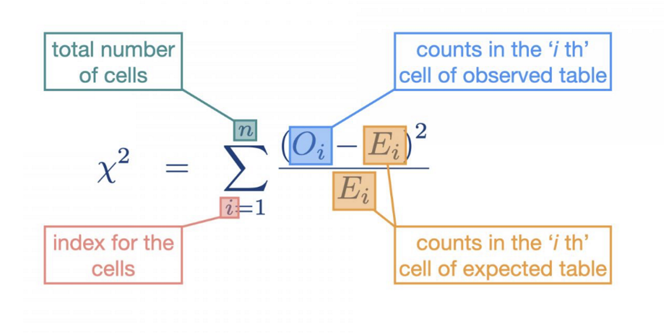
Module 9
Expected Contingency tables
contingency table of expected frequencies from a population where the null hypothesis is true.
One-way expected contingency tables
Studies with one categorical variable in which the contingency table is always given as counts
H0 = The counts in one-way contingency table are distributed equally among all levels.
typically has fractional values because it represents the average from a statistical population
Two-way expected contingency tables
Studies with two categorical variables have 2-way contingency tables.
H0 = counts are distributed independently among the cells
Chi squared score (x^2)
distance between observed and expected contingency tables
Chi squared distribution
describes the likely variation in chi-squared scores that are due to sampling error alone
Chi squared test
Hypothesis tests for categorical data where the hypothesis test works by locating the critical ꭓ2 score (ꭓ2C) that corresponds to the Type I error rate on chi-squared distribution and comparing that to the observed ꭓ2 score (ꭓ20).

Slide 17
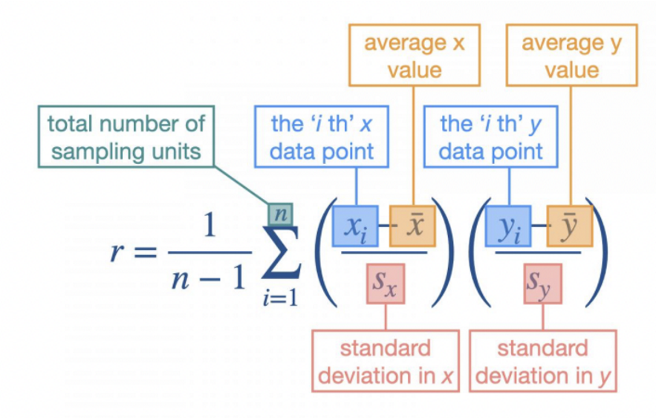
Module 10
Correlation hypothesis test
Evaluate whether there is association between 2 numerical variables
Correlation test
Strength of association between two numerical variables is measured by Pearson's correlation coefficient (correlation coefficient)
Bivariate normal distribution
extension of the normal distribution for two numerical variables that allows for an association between them

Slide 18
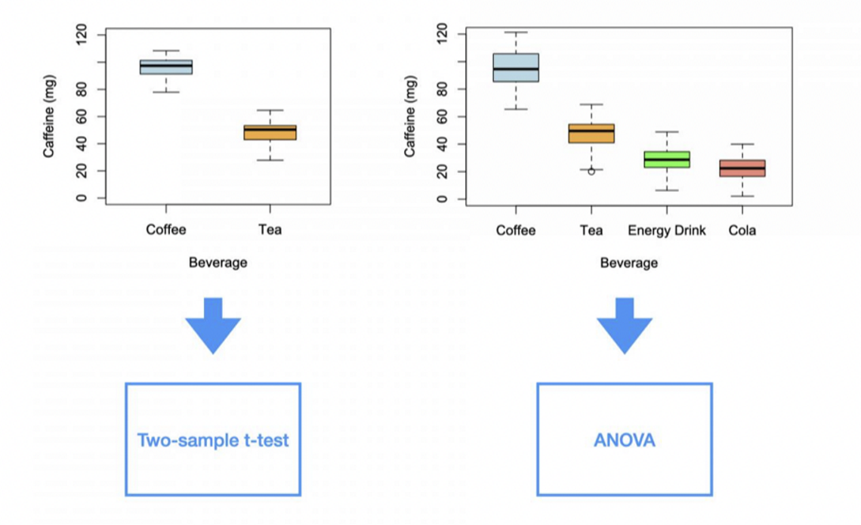

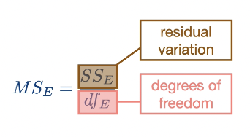
Module 11
F-test
Used to evaluate the difference in variance between two groups
Ratio of variances(F-score)
Used in the F-test to quantify the ratio of two variances.
The observed F-score can be calculated as FO=s2A/s2B where s2A is the variance of group A and s2B is the variance of group B.
F-distribution
Null distribution of F-scores from a statistical population where the variances of two groups are the same
ANOVA (or Analysis of Variance)
Statistical method used to work with data with both numerical and categorical variables
works by partitioning the data into two sources of variation:
Group variation - The variation between the group means and the overall grand mean.
Residual variation - The variation between the sampling units and the group means.
Calculation of group variation (aka mean square of groups (MS_{G}))
Calculated as the sums of squares of groups (SSG) divided by the degrees of freedom of groups (dfG)
SS_{G} = difference of mean of each group from the grand mean squared
CALCULATION OF RESIDUAL VARIATION (aka mean square error (MS_{E}))
Calculated as sums of squares error divided by degrees of freedom.
SS_{E} = difference form each data point of sampling unit and the group mean squared.

Slide 19
MODULE 11 CONT.
Post-Havoc Test
Post hoc tests are secondary statistical tests designed to indicate what groups have different means in an ANOVA.
Specifically, a post hoc test evaluates whether group means are different while controlling for the Type I error rate for all comparisons among groups.
Tukey HSD Test
Tukey HSD is one type of post hoc test that compares the means of all possible contrasts. It uses a specialized null distribution to adjust for the number of contrasts.
Contrast Statement
A test of the difference in means between two groups in an ANOVA
Family-wise Error rate
The Type I error rate for the family of contrasts

Slide 20
Module 12
TWO-FACTOR ANOVA
Two-factor ANOVAs build on single-factor ANOVAs to consider two categorical variables, which allows for the evaluation of each variable as well as their interaction.
INTERACTION
Interactions are evaluated as deviations from additivity, where additivity is the idea that the combined effects of two variables is the simple sum of each considered in isolation.
Interactions are typically visualized using interaction plots rather 3 than box plots.
INTERACTION PLOT
a specialized plot that highlights the interaction pattern between two categorical variables.
MAIN EFFECTS
is another name for a categorical variable in a two-factor ANOVA.
ADDITIVITY
is when the response to the combination of two levels is simply the sum of the two.
CELL
is the group of sampling units that corresponds to the joint levels of two categorical variables.

Slide 21
Past exam question review

Slide 22
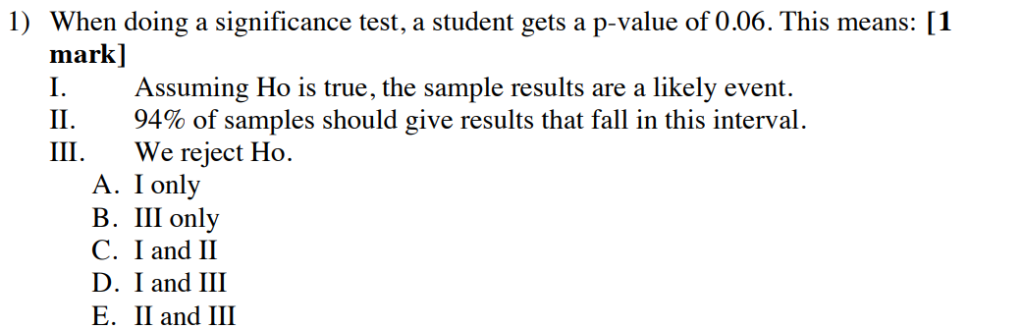


Slide 23
Answer: A

Slide 24
Past exam question review

Slide 25




Good Luck with your exams!

